Slide 1

Aim: Case Study of Dev-ops and Different Tools and Presentation
case study on Dev-ops

Slide 2
Introduction
DevOps is a modern software development approach that enables continuous delivery and collaboration between development and operations teams. This case study provides a step-by-step guide to presenting DevOps principles, challenges and potential solutions. It covers various tools and technologies, including CI/CD pipelines, containerization, version control and monitoring. A real-world case study is also presented, illustrating how DevOps practices and tools have been implemented by a specific organization. The benefits of adopting DevOps, such as shorter time-to-market, reduced errors, and increased efficiency, are also discussed. Finally, the importance of DevOps in modern software development and the role of tools in streamlining processes are emphasized.

Slide 3
common challenges in traditional software development
Siloed Teams:
Challenge: Isolated teams with distinct roles.
DevOps Solution: Encourages cross-functional collaboration, breaking down silos.
Slow Release Cycles:
Challenge: Lengthy release cycles and delayed updates.
DevOps Solution: Promotes continuous integration and delivery for faster and reliable releases.
Limited Collaboration:
Challenge: Insufficient communication between development and operations.
DevOps Solution: Emphasizes collaboration, communication, and shared responsibilities for improved efficiency.
Manual Processes:
Challenge: Error-prone manual processes leading to deployment failures.
DevOps Solution: Prioritizes automation to reduce errors and streamline workflows.

Slide 4
DevOps Transformation
DevOps is a set of practices that combines software development (Dev) and IT operations (Ops) to shorten the systems development life cycle while delivering features, fixes, and updates frequently and reliably.
A DevOps transformation can address the challenges of traditional software development by improving collaboration, enabling continuous delivery, and reducing errors.
Faster and More Frequent Software Releases
DevOps enables faster and more frequent software releases by automating the build, test, and deployment processes. This allows developers to quickly iterate on new features and fixes, and deliver them to users more quickly.
Reduced Errors
DevOps also reduces errors by automating the testing and deployment processes. This ensures that code is thoroughly tested before it is released to users, reducing the likelihood of errors and bugs.

Slide 5
DevOps Tools and Technologies
CI/CD Pipelines
Jenkins: Automation server used for building, testing, and deploying software.
Travis CI: Cloud-based CI service for testing and deploying code changes.

Slide 6

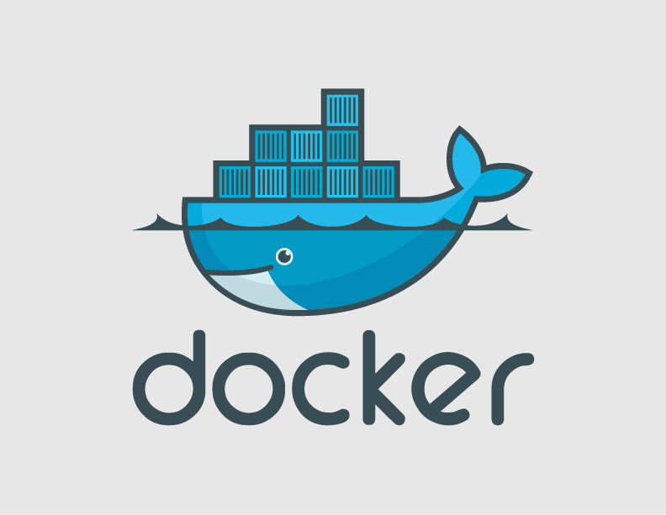
DevOps Tools and Technologies
Containerization
Docker: Platform for developing, shipping, and running applications in containers.
Kubernetes: Container orchestration tool for automating deployment, scaling, and management of containerized applications.
This Photo by Unknown author is licensed under CC BY-SA.

Slide 7
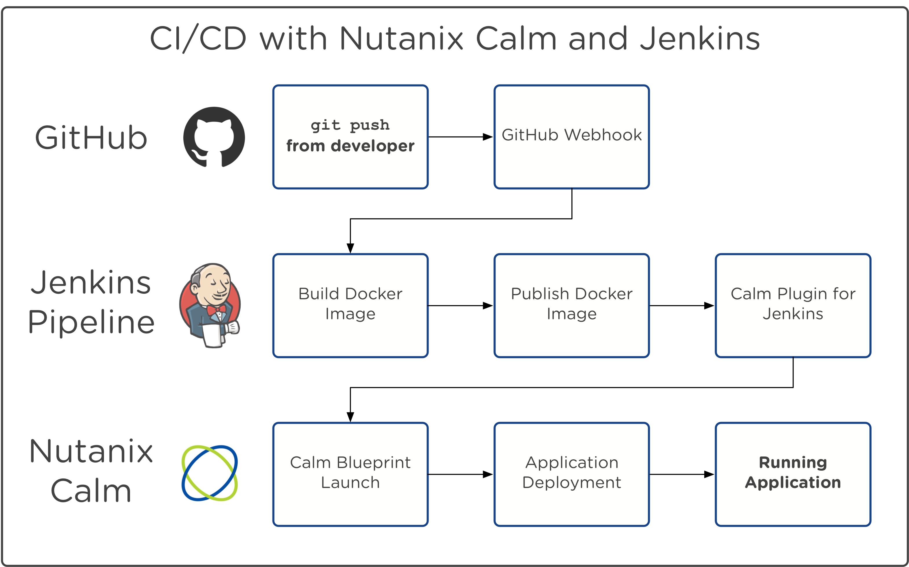
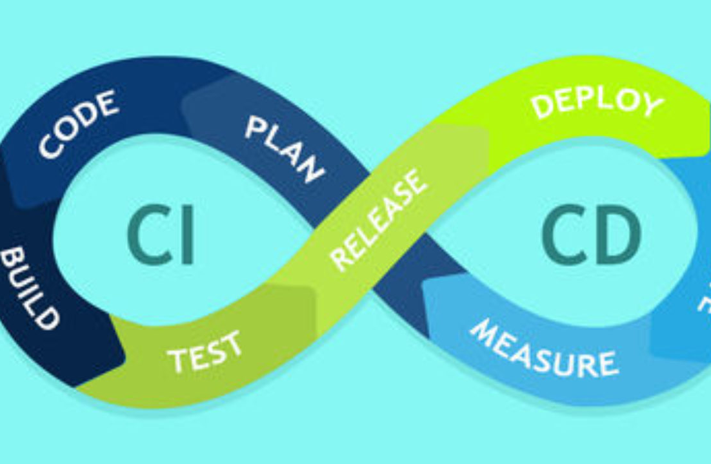
DEVOPS TOOLS AND TECHNOLOGIES.
Version Control and Monitoring
Git: Distributed version control system for tracking changes in source code during software development.
Prometheus: Monitoring and alerting toolkit used for recording real-time metrics in a time series database.
Explanation:
CI/CD Pipelines: These tools automate the process of integrating code changes, testing them, and then deploying them to production, ensuring a continuous and efficient software delivery pipeline.
Containerization: Docker and Kubernetes enable the creation, deployment, and management of containers, allowing for consistent and reliable application deployment across different environments.
Version Control and Monitoring: Git helps teams track and manage changes to source code, while Prometheus provides real-time monitoring and alerting to ensure the health and performance of the software system.

Slide 8

Case Study - DevOps Implementation
Organization Overview
Company: XYZ Enterprises
Industry: E-commerce
Challenge: Slow release cycles, manual deployment processes, and frequent production issues.

Slide 9

DevOps Implementation Challenges
Slow Release Cycles: Releases took weeks due to manual testing and deployment processes.
Manual Deployment: Error-prone manual deployments led to production issues and downtime.
Lack of Automation: Limited automation resulted in inefficiencies and inconsistencies in the development and deployment processes.

Slide 10

DevOps Tools and Implementation
Tools Selected: XYZ Enterprises implemented Jenkins for CI/CD pipelines, Docker for containerization, Git for version control, and Prometheus for monitoring.
Implementation: Automated testing, continuous integration, and deployment pipelines were set up to streamline the release process. Docker containers were used to ensure consistent deployment across environments, and Git enabled version control and collaboration. Prometheus was implemented for real-time monitoring and alerting.

Slide 11

Outcomes and Benefits
Faster Releases: Release cycles reduced from weeks to days, enabling faster delivery of new features and updates.
Improved Reliability: Automated testing and deployment processes led to fewer production issues and improved system reliability.
Enhanced Efficiency: DevOps practices and tools resulted in increased efficiency, collaboration, and consistency across the development and deployment lifecycle.

Slide 12
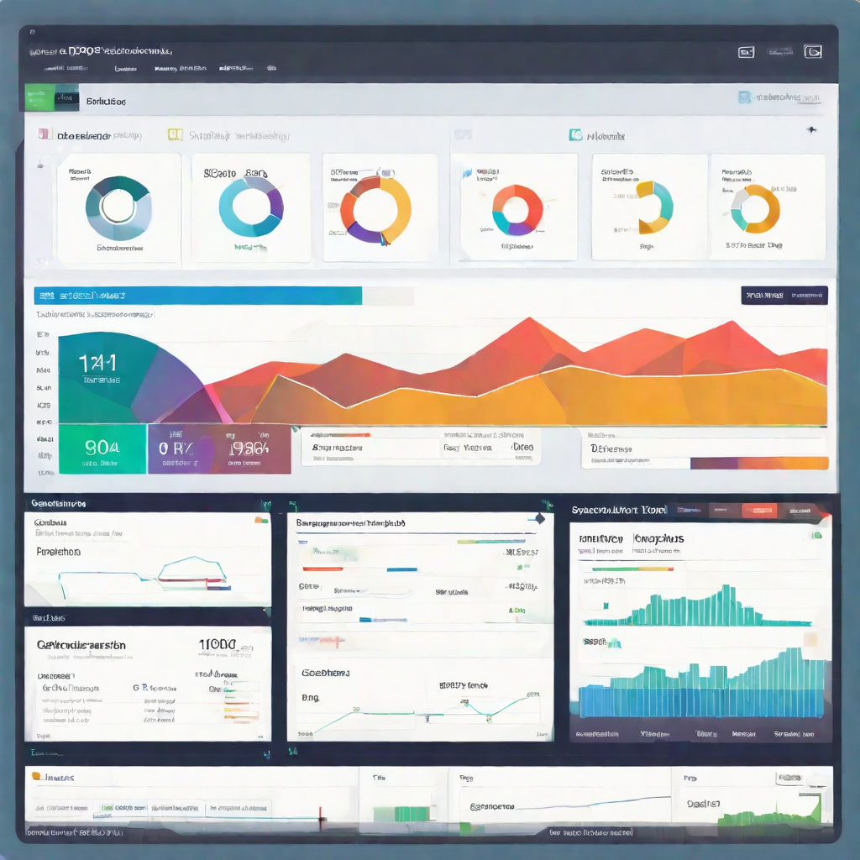
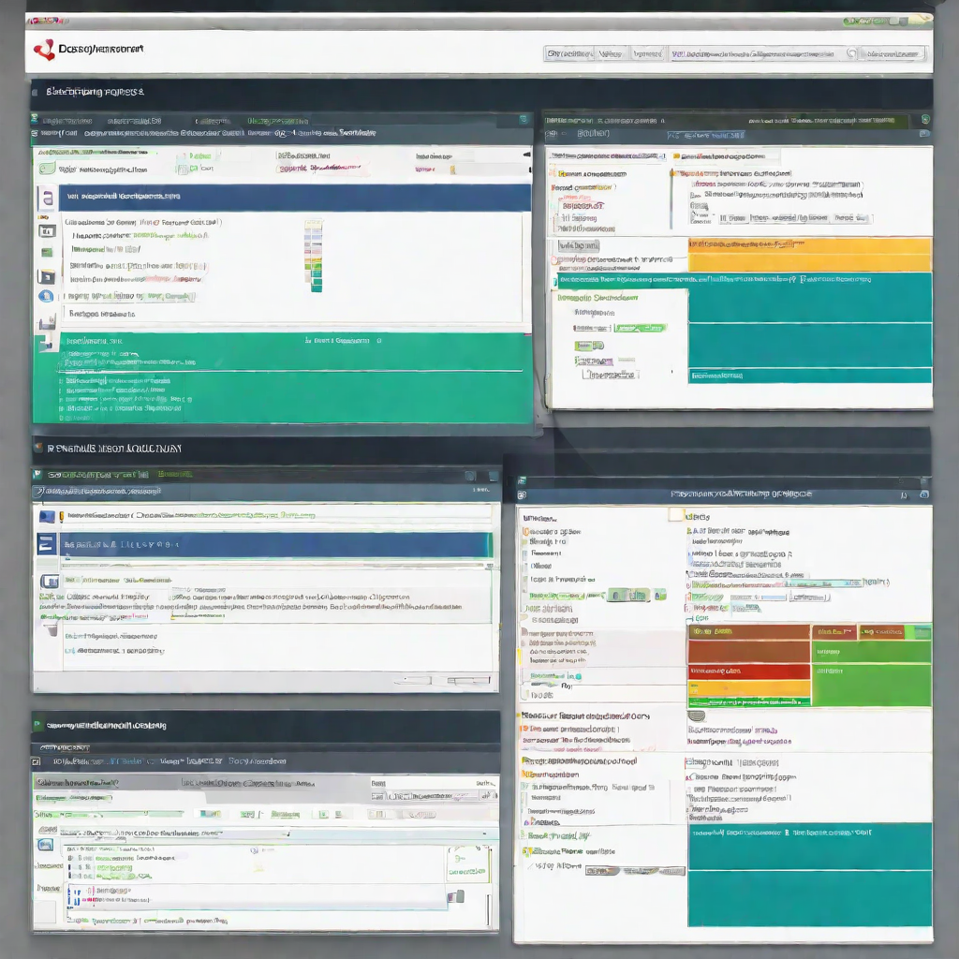
DEMO
As part of a DevOps environment, seamless tool integration is crucial for efficient software development and deployment.

Slide 13



Benefits
Shorter Time-to-Market
DevOps practices enable faster delivery of software products and updates. Continuous integration and continuous deployment (CI/CD) pipelines automate the software development process, reducing manual effort and enabling rapid deployment to production environments.
Increased Efficiency
DevOps principles promote collaboration and communication between development, operations, and other teams involved in the software development lifecycle. By breaking down silos and fostering cross-functional collaboration, organizations can achieve greater efficiency and productivity.
Reduced Errors
By automating build, test, and deployment processes, DevOps practices minimize the risk of human error. Continuous monitoring and feedback loops help identify and resolve issues early in the development cycle, reducing the likelihood of errors in production.

Slide 14

Conclusion
DevOps plays a crucial role in modern software development by fostering collaboration, automation, and continuous improvement across the development and operations teams. The use of tools such as Jenkins, Docker, and Git streamlines processes, enabling faster delivery, improved quality, and enhanced reliability of software products in today's dynamic and competitive landscape.

Slide 15

Q & A

